Slide 1


CSE 6324 ITERATION- 2 PRESENTATION
Team – 9
Sharma Arnav – 1002070507
Ashraf Abdul Rafay – 1001918598
Mohammed Ishraq – 1002082521
Nikhil Kamble - 1001837272

Slide 2
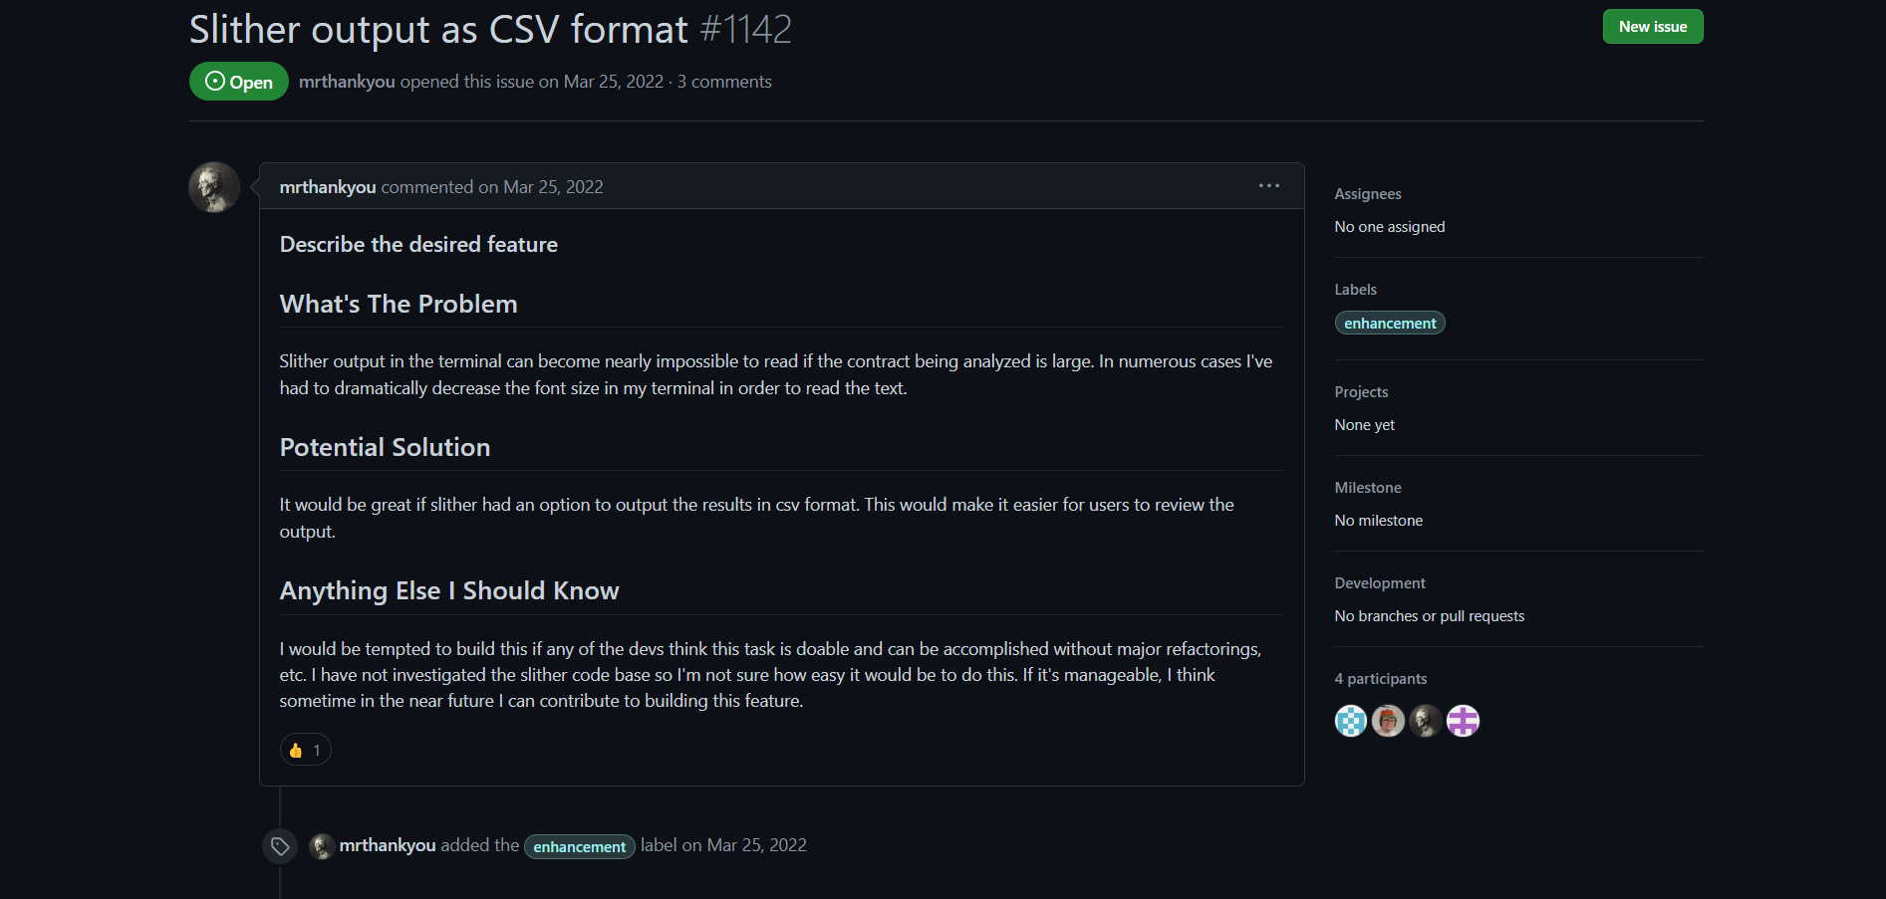
Issue #1:

Slide 3
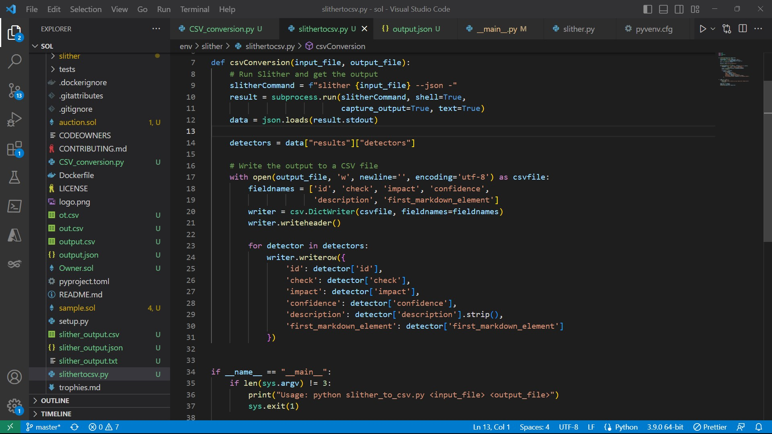
Issue #1: Pseudo Code

Slide 4
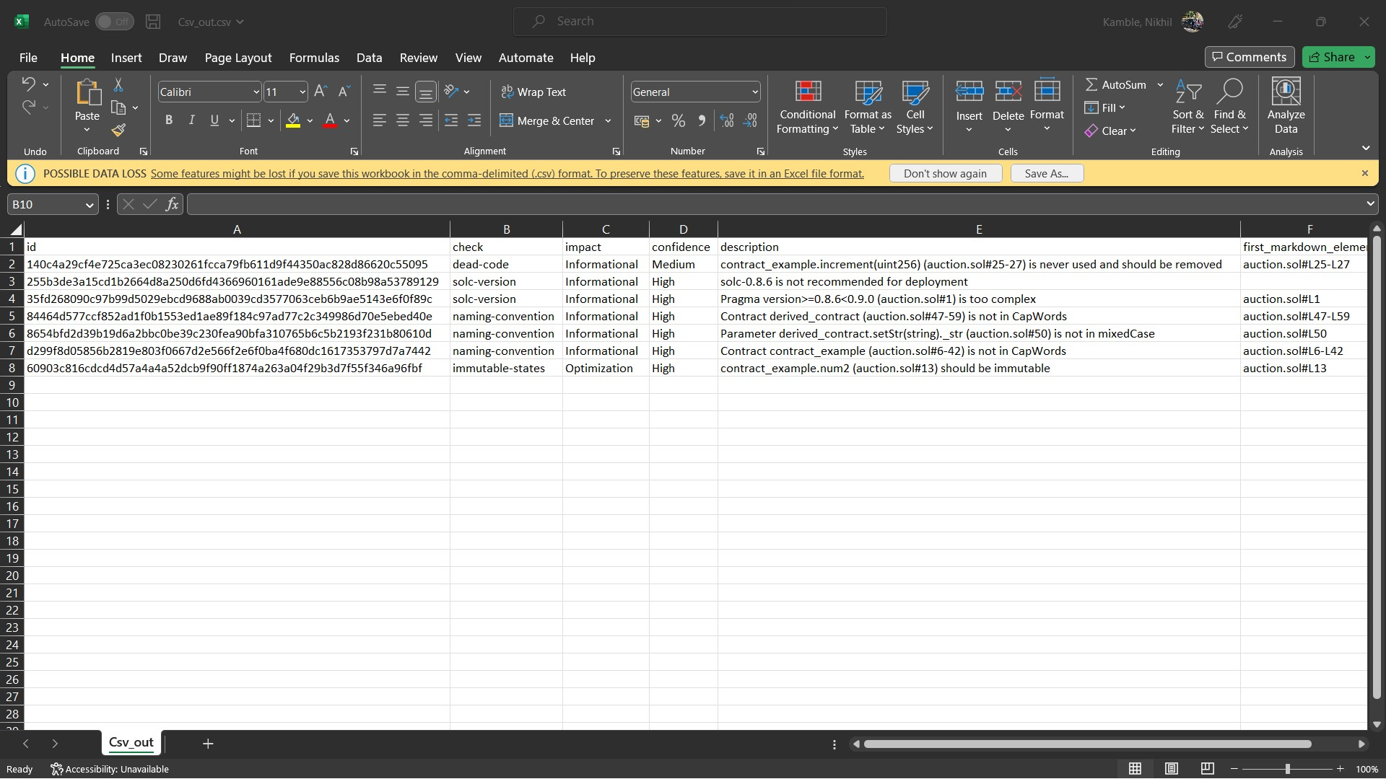
Issue #1: CLI Command
Issue #1: CSV Output

Slide 5
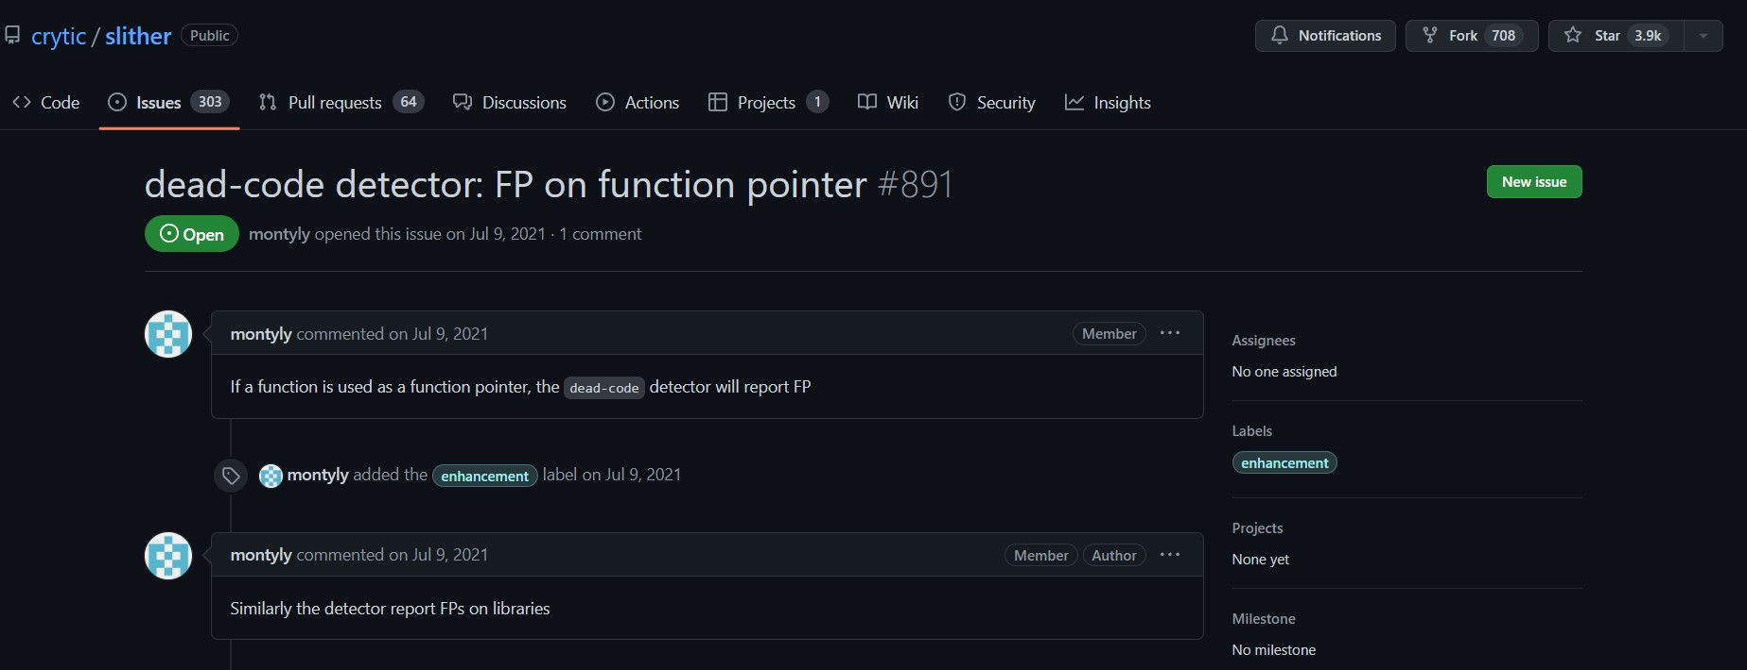
Issue #2:

Slide 6
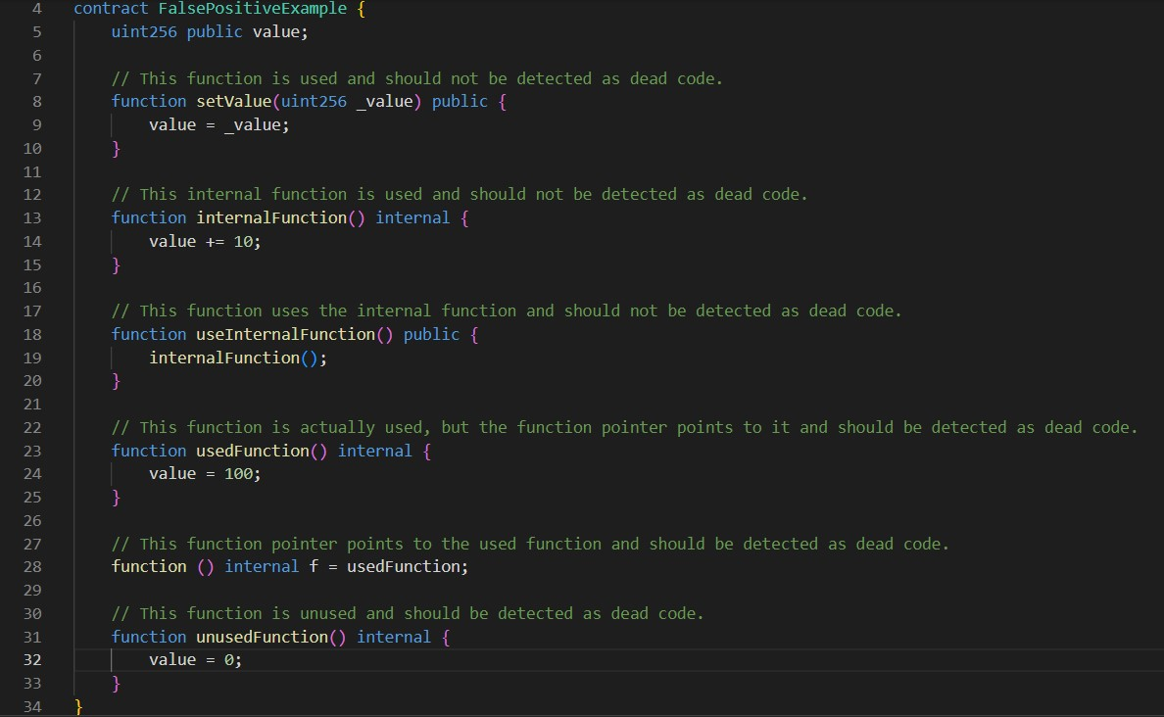
Issue #2: Sample Contract

Slide 7
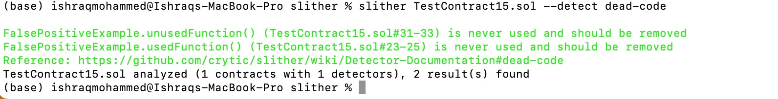
Issue #2: CLI Output with Current Implementation

Slide 8
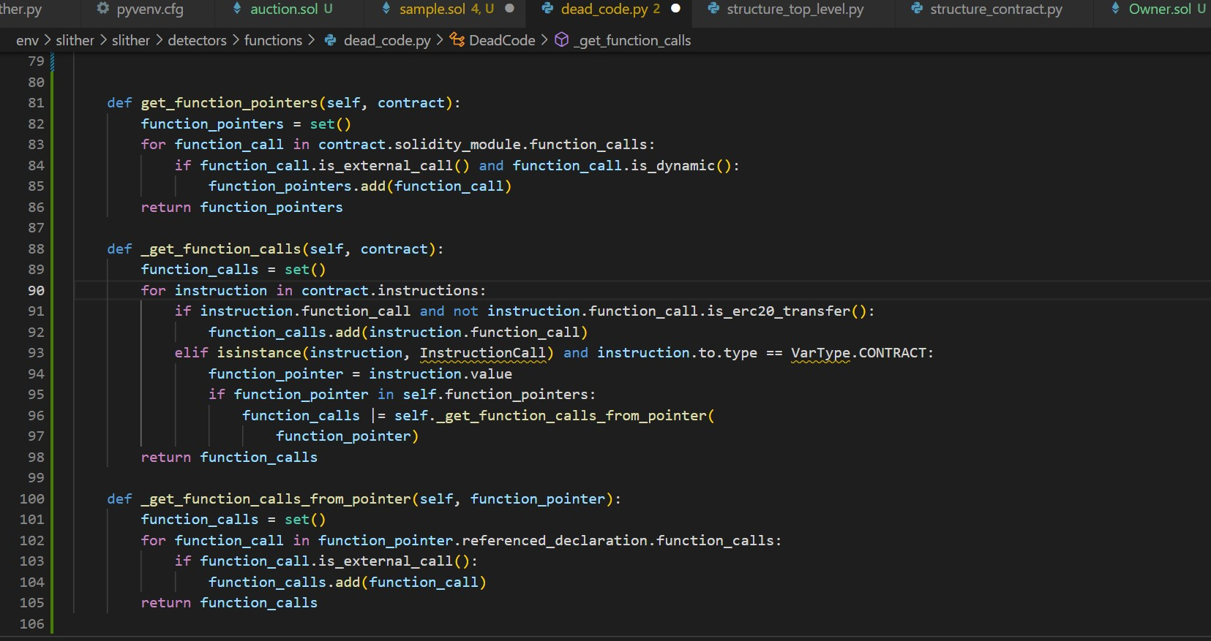
Issue #2: Pseudo Code

Slide 9
Project plan - Iteration #2:
Testing
The Pseudo Code for CSV conversion to identify Vulnerabilities if any.
Developing
A new method to track the function pointers that are used in the contract.
Modifying
The _get_function_calls method to consider the dynamic behavior of function pointers.
Adding
A new method to retrieve the set of function calls from a function pointer.
Modifying
The analyze method to initialize the set of function pointers and to retrieve the set of function calls from function pointers.
Review
Changes from iteration 1.

Slide 10
Project plan - Iteration #3:
Testing
The modification in Dead_code.py to identify new vulnerabilities if any.
Modifying
Rigorous unit testing.
Developing
Code optimization.
Review
Changes from iteration 2.

Slide 11
Competitors:
Mythril:
Securify:
Mythril provides a CSV output format that can be used for further analysis and manipulation of data.
The tool is designed to detect various security vulnerabilities, including reentrancy, gas-related vulnerabilities, and integer overflows/underflows.
Mythril can also detect issues with the contract's code, such as dead code or unreachable code.
Securify is a security analysis tool for smart contracts that provides a JSON output format.
The JSON output can be easily converted to CSV format using a third-party tool.
Securify uses a combination of static analysis and dynamic analysis to identify potential security vulnerabilities in the contract.

Slide 12

Risk Factors:
Security risks
Maintenance costs
Performance issues
Code quality
Resource consumption

Slide 13
Use Cases:
Improve accuracy of dead-code detection in programs that use function pointers
01
Identify unused or unnecessary functions in smart contract code
02
Improve program maintenance and code quality
03
Improve program performance and resource consumption
04

Slide 14
User Feedback:
# | Customer/User | Feedback | Suggestions/Comments
1 | Reena Ughade – Smart Contract Enthusiast | This would make it easier for users to review the output. | having the option to get a csv (or txt) output directly from the CLI would be a very good idea
2 | Sagar Jadhav – solidity Beginner | Good concept | I think sometime soon I can contribute to building this feature.
3 | Girish Pagare – Solidity developer | Slight, But good addition overall. Great job...!! | Converting Slither output to CSV format will provide a more accessible and flexible way to analyze and work with the results of Slither analysis.

Slide 15

The End
We are open for Questions

